Slide 1
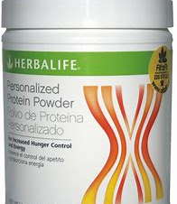
Become lean and feel great with Herbalife’s protein shake miracle
By Ritika Bhadoo

Slide 2

Consumer Objective
Herbalife Protein Shake
Target Audience: - 19-45 year old males and females who wants to reduce weight
Duration of campaign : - 6 months
Repurchase

Slide 3
Consumer Objective
To achieve repurchase of Herbalife protein shake amongst 25% of loyal customers (19-45year old males and females on dieting )within 6 months campaign

Slide 4
Trade Objectives
To build strong connections with key buyers and retail managers in order to guarantee Herbalife Protein products are prominently displayed and promoted.
To obtain distribution agreements with major retail chains, with a goal of increasing retail presence by 15%.

Slide 5
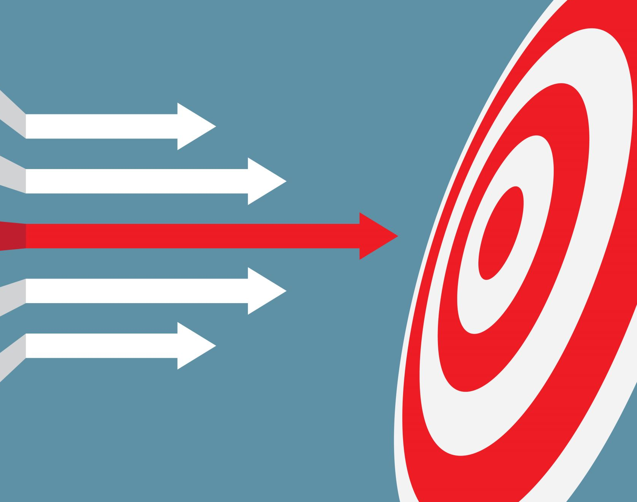
Target Audience

Slide 6
Consumer Target Audience
Demographic Profile
Active adults between the ages of 25 and 45 who are health-conscious.
Fitness Enthusiasts: People who regularly exercise, work out, or participate in sports and want to improve their fitness by using protein supplements.

Slide 7
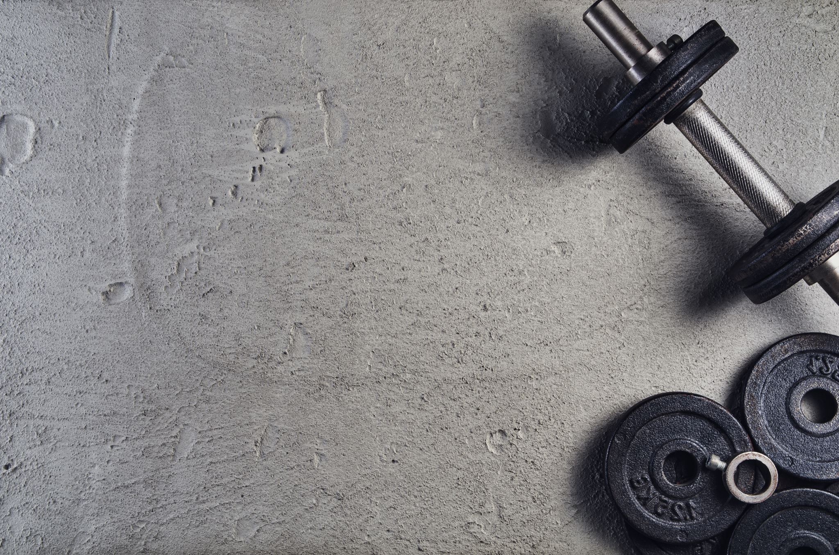
Psychographics
Individuals seeking easy and effective protein shake supplements to help them achieve their fitness objectives.

Slide 8
Customer Type
Loyals: - some people are using the products of herbalife from the long time so that individual will definitely in the target
Competitive Loyals: - some people are buying the product of other brands like PhenQ, AG1 etc.

Slide 9
Trade target
Buyers in retail chains in charge of health and wellness product areas
Store managers and in-store salespeople for big retail businesses.

Slide 10
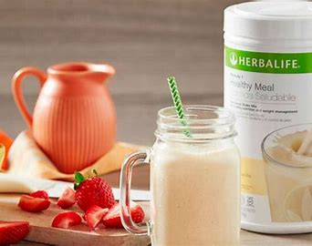
Consumer attitude
Customers want handy, high-quality protein supplements to help them get the most out of their exercises and daily routines.
Herbalife Protein is a dependable option that fits well with their active lifestyles.

Slide 11
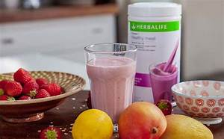
Trade attitude
Decision maker: =Trade professionals want to offer products that appeal to their health-conscious clientele.
Marketer: - good budget to promote the product
Sales Associate: - more sales more commission

Slide 12

Key Message

Slide 13
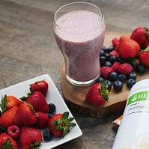
For Consumers
Nutrition that is both convenient and delicious, make it simple to monitor the amount of calories consumed

Slide 14

For Trade
High demand contributes to increased sales, and there are no waiting stockpiles in warehouses.

Slide 15
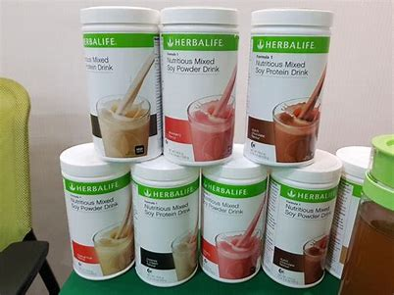
Proof

Slide 16

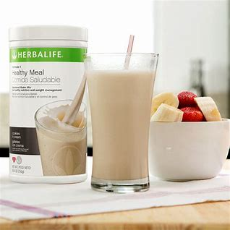
Consumer
Since 1980, the company has been on a mission to improve nutritional habits around the world by providing great-tasting, science-backed nutrition products that help people receive the correct balance of good nutrients.
Every day, millions of Herbalife Nutrition shakes are consumed around the world.
This person-to-person, high-touch encounter is important to our aim of improving our communities' nutritional habits, and it is what sets us apart.

Slide 17
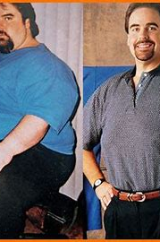

Jim Poore
The man reduced near about 110 kg by taking Herbalife protein shake

Slide 18
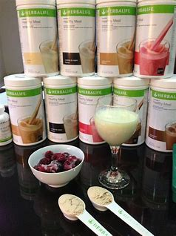
Trade
Sales growth in stores that carry Herbalife Protein, as well as endorsements from industry professionals.
Company sold 87 million canisters of protein shakes worldwide in 2021, totaling 1.9 billion servings.

Slide 19
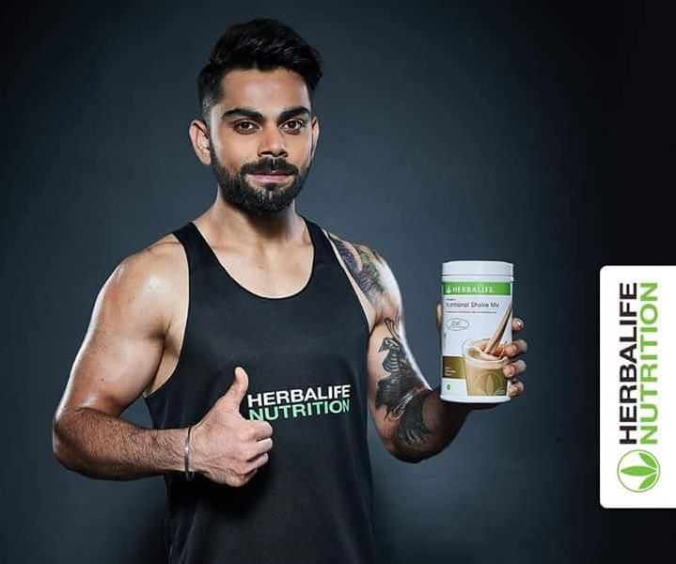
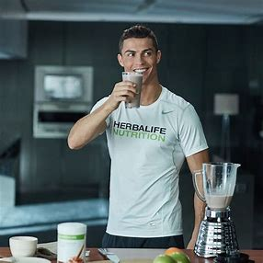
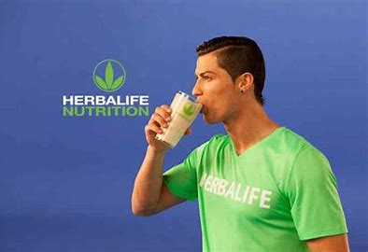

Slide 20

Desired Response Company Want

Slide 21
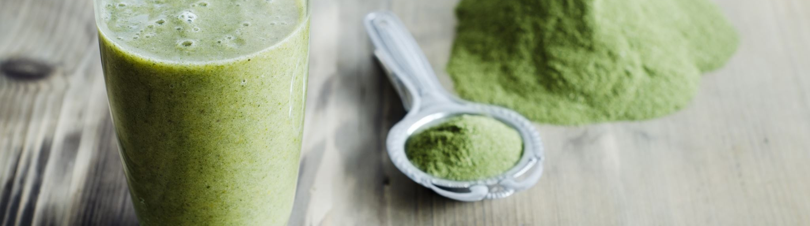
From Consumers
Purchase the protein shake of Herbalife and repurchase of the same product and be the loyal customer of Herbalife.

Slide 22
From Trade
Decision maker : - Stock and market Herbalife protein products near the shop location.
Marketer: - Give company a good space for point of purchase
Sales associate: - refer the Herbalife protein shake to more people

Slide 23

Tone and Manner
The organised campaign's tone will be vigorous, informative, and engaging. It will emanate optimism, encouraging people to live a healthy and active lifestyle. To connect with the audience on a deeper level, the style will be engaging, interactive, and personalised.

Slide 24

The campaign's key concept is "Elevate your way of life with Herbalife Protein Shake." The ad will highlight how Herbalife Protein Shakes can be a crucial element of a health-conscious individual's daily routine, assisting them with achieving fitness objectives and keeping up an active lifestyle.

Slide 25
Consumer Promotion Strategy

Slide 26
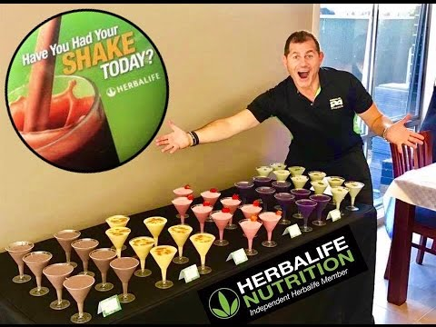
Sampling
To attract the target audience
Distribute the protein shake at the gym , healthcare centre and sports centre

Slide 27
Bonus Packs
The company is giving 100gram protein shake free when a person is buying 2 of 250 grams

Slide 28

Trade Promotion Tactics

Slide 29

Free Product( for decision maker)
To encourage the CEO to buy product Herbalife will give free products if the order is above 20,000.

Slide 30
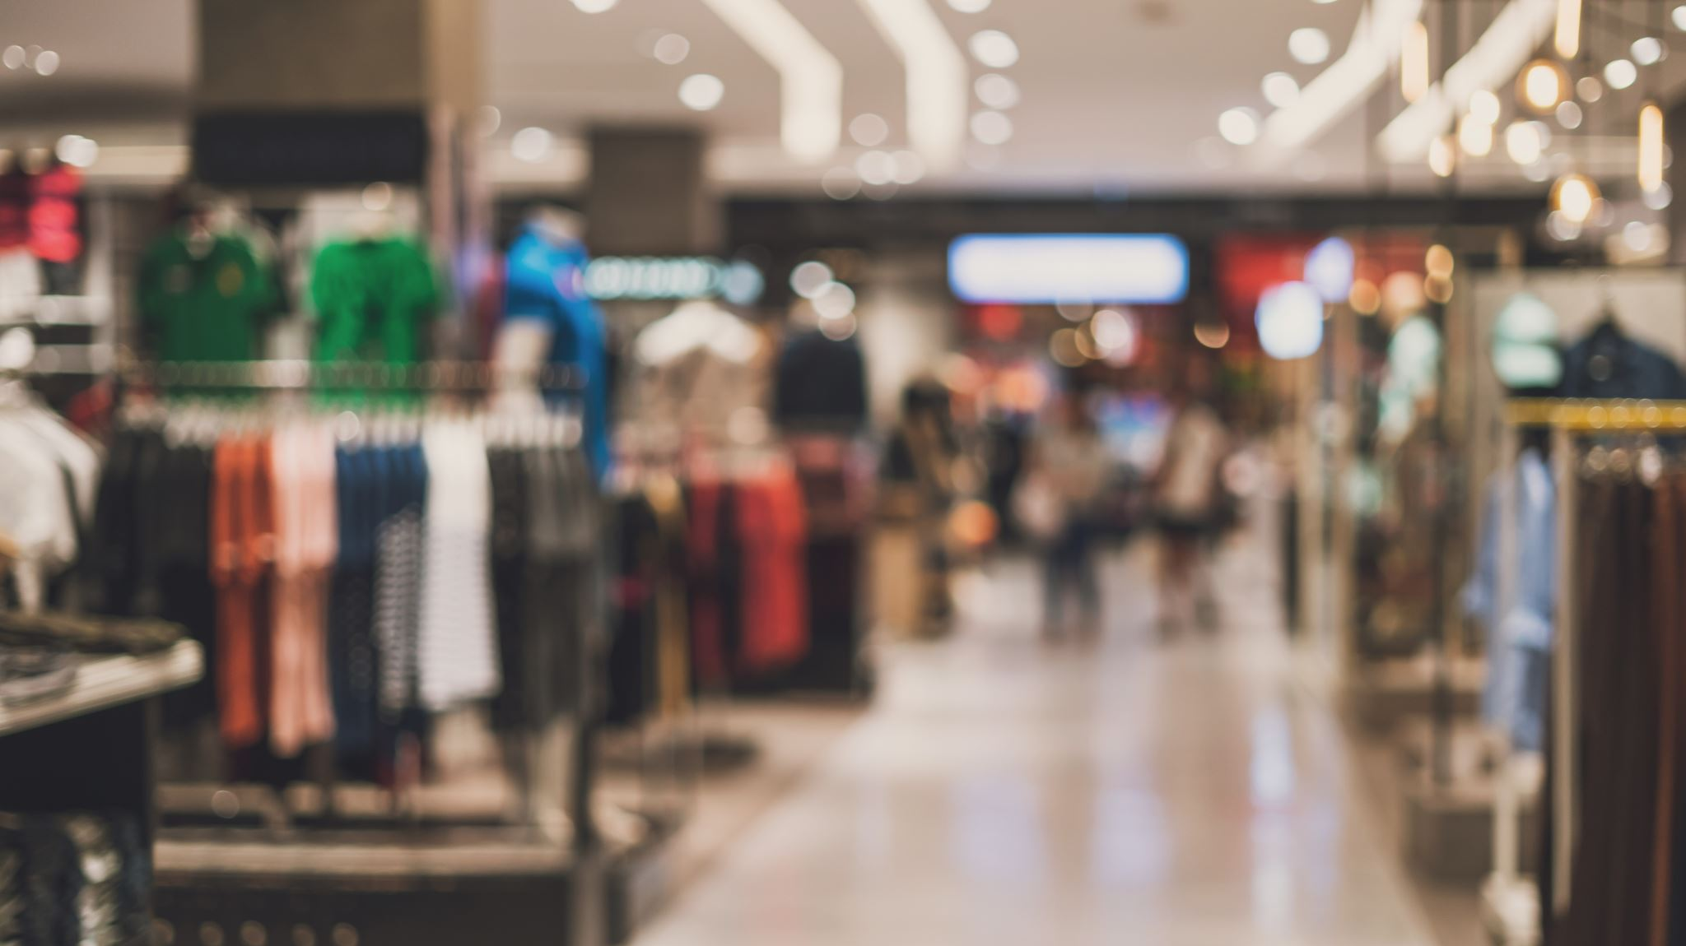
Display Allowance (for the marketer)
The company Herbalife will provide the marketer the money so the marketer can spend it and do the promotion of products easily by buying a space at crowded shopping centre.

Slide 31

Spiffs (for personal sellers)
If the sales associates will sell 5 protein shake of Herbalife then that personal seller will get $50 extra pay.

Slide 32
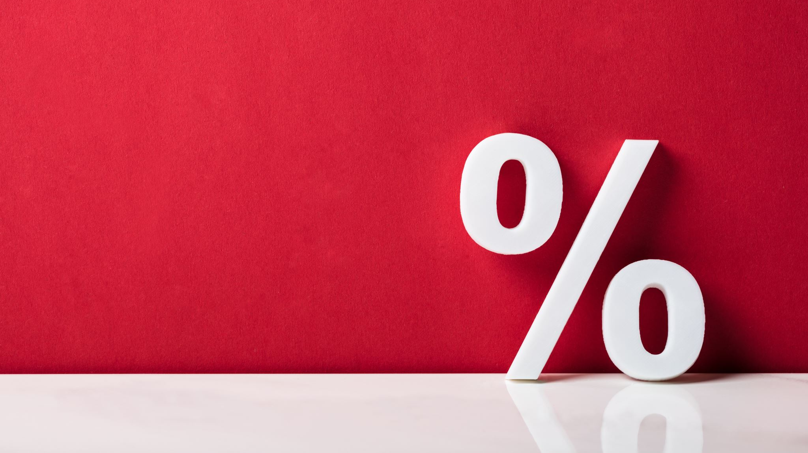
Sales Promotion tactics (mockup)
Consumer Promotion Tactic: Create a visually appealing internet banner announcing the limited-time offero get the bonus pack, displaying product photographs, and utilising intriguing language.
Trade Promotional Strategy: Create an advertising piece showing purchasing in bulk discounts and benefits for shops, as well as statistics on improved sales with Herbalife items.

Slide 33

Consumer ad strategy
Media type: - Social Media Advertising (Instagram and Facebook)
Age: -Users between the ages of 19 and 45 who are interested in exercise, nutrition, and going gym daily.
Reach: Targeted exposure of 500,000 users.
Budget: - 1M
DURATION: - 6 months

Slide 34


Slide 35
Trade magazine ad strategy
Choice of Trade Magazine: "The retail sector Developments in Healthcare and Wellness“
Target Audience: retailers and buyers in the fitness and wellness business.
Circulation: 20,000 copies.

Slide 36
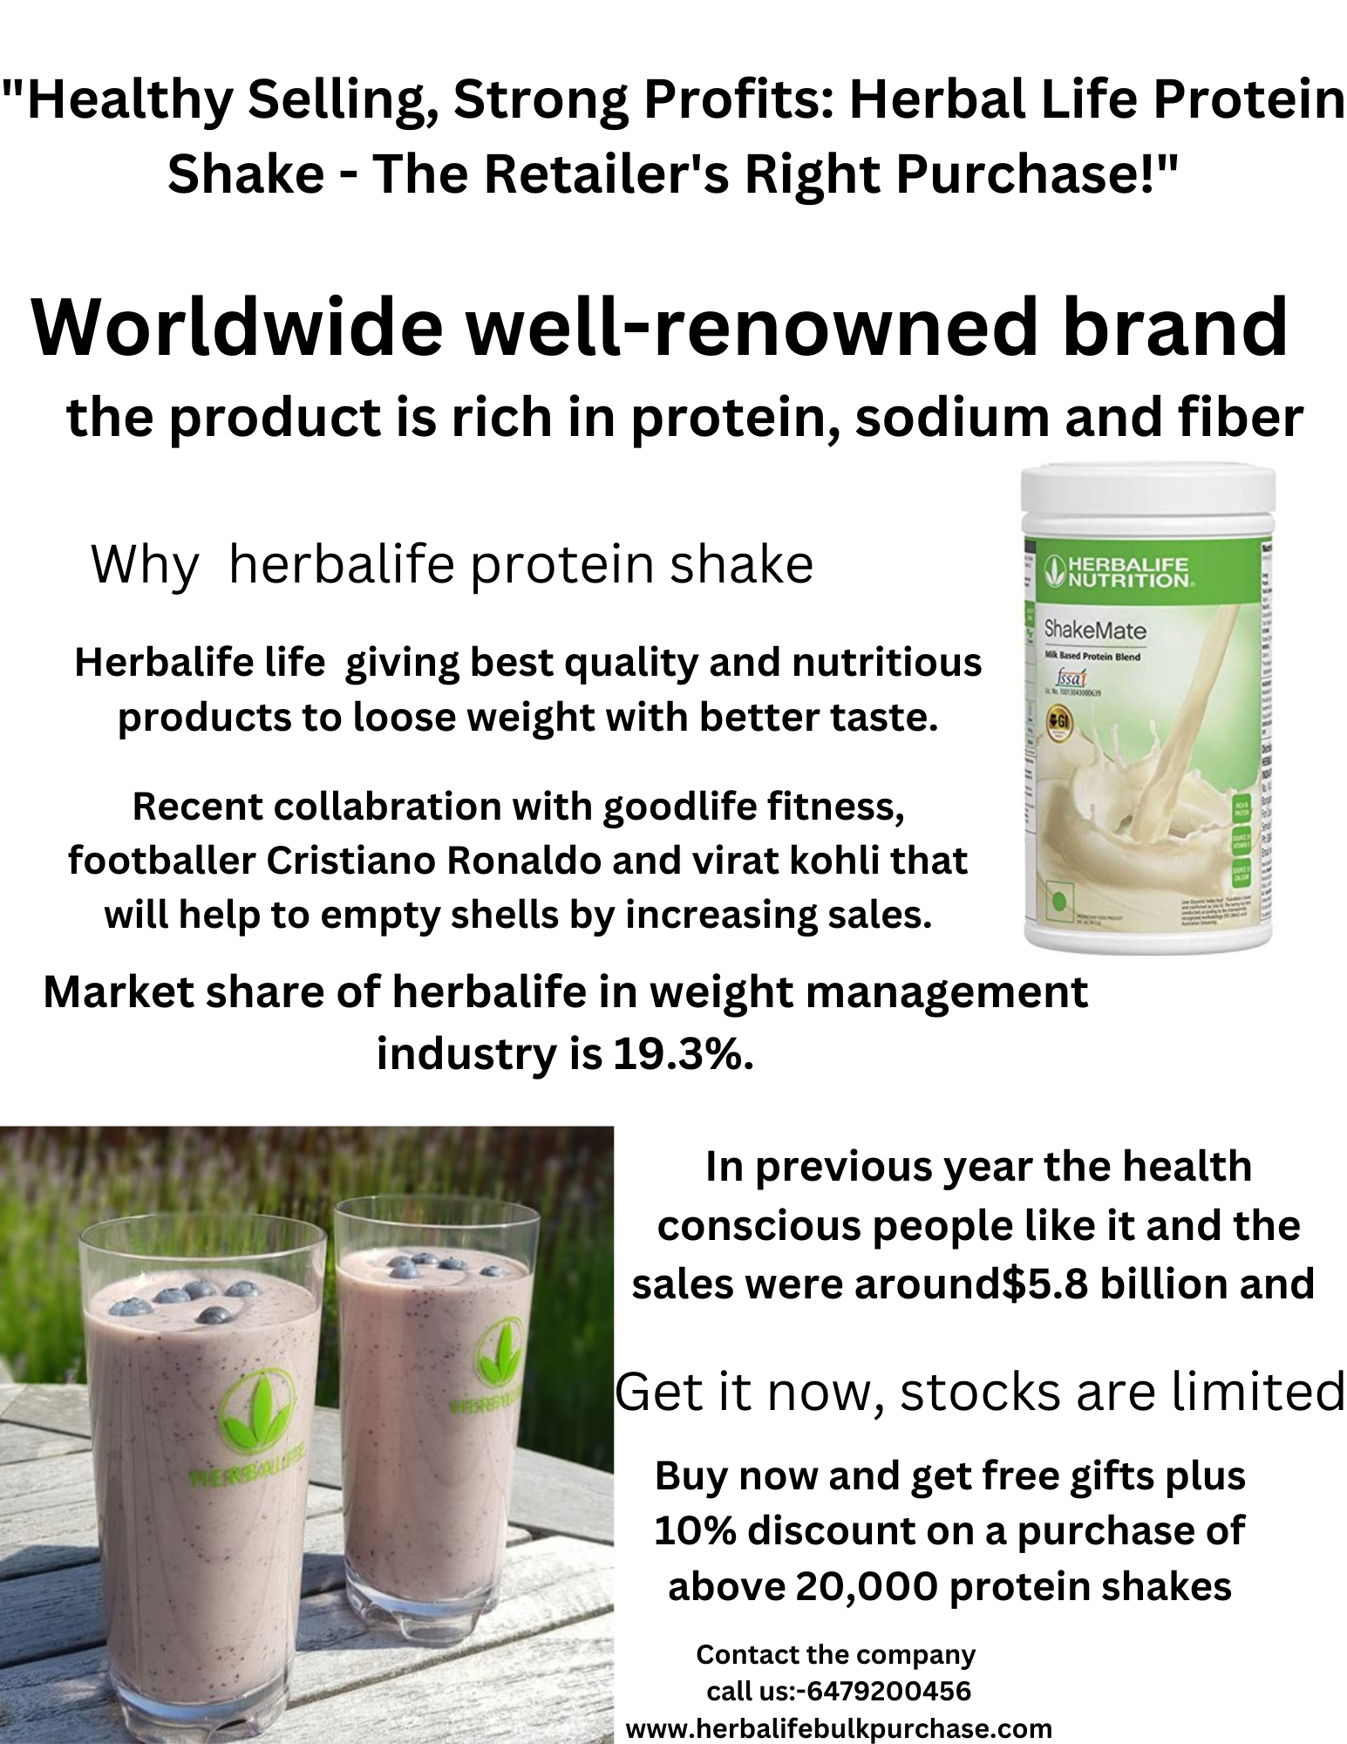

Slide 37

Summary
The main aim of this campaign is to increase the sales of herbal life protein shake among the consumer and trade. Company wants the consumer to buy and repurchase the product. On other hand for trade Herbalife want the retailer to buys more stock and give promotions. Company tried to encourage the consumer (target-19-45 years old) trade by using some tactics like bonus pack, sampling , discount and display window show.

Slide 38

Success of campaign
The company will do the data analysis with metric that includes following
consumer participation on social media
retailer feedback and sales statistics
website traffic
conversion rates
For trade how many retailers bought how much products help the company to realize weather the campaign is successful or not.

Slide 39
Thankyou

Slide 40
References
https://cc.bingj.com/cache.aspx?q=what+is+meaning+of+tone+and+manner+of+the+campaign&d=4960202209907687&mkt=en-CA&setlang=en-IN&w=r5ZtYxvl817Po_N3y0twKcNaY-sp7oZk#:~:text=https%3A//www.brafton.com/blog/creation/4%2Dbrand%2Dtone%2Dof%2Dvoice%2Dexamples%2Dto%2Duse%2Dwhen%2Dbuilding%2Dyour%2Down/
https://www.statista.com/statistics/1007635/herbalife-s-market-share-of-selected-industries-worldwide/
https://www.bing.com/search?q=sales%20of%20herbalife%20protein%20shake&FORM=ARPSEC&PC=ARPL&PTAG=30136#:~:text=Weight%20Management%20%2D%20Herbalife-,iamherbalifenutrition.com/healthy%2Dweight/benefits%2Dprotein%2Dshakes%2Dformula%2D1/,-Was%20this%20helpful

Slide 41
https://www.bing.com/search?q=constumer%20reviews%20of%20herbalife%20protein%20shake&FORM=ARPSEC&PC=ARPL&PTAG=30136#:~:text=and%20Shakes%20Reviews%20%E2%80%A6-,https%3A//www.purefoodcompany.com/herbalife%2Dprotein%2Dpowder%2Dreview,-Would%20definitely%20buy
https://www.bing.com/search?q=whatb%20was%20the%20sales%20of%20protein%20shake%20herbalife&FORM=ARPSEC&PC=ARPL&PTAG=30136#:~:text=Weight%20Loss%3F%20%2D%20Healthline-,www.healthline.com/nutrition/herbalife%2Dreview,-Was%20this%20helpful

