Slide 1
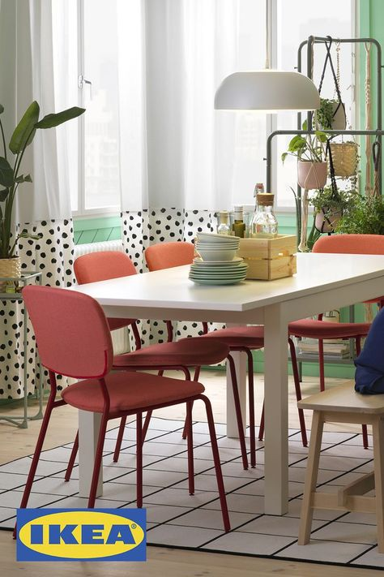
Assignment
3 pr toolkit
By Ritika Bhadoo, Amandeep kaur

Slide 2

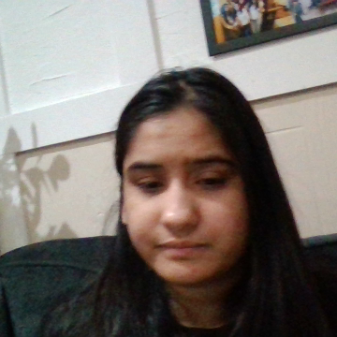
To promote “IKEA style discoveries” pop event we are making public relations tools to communicate with various agencies about show and get help in the promotion of the show
"

Slide 3
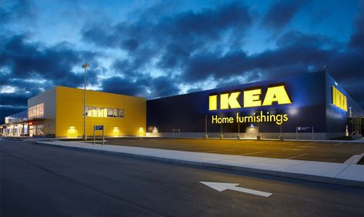
Objectives
To get direct contact with the target audience and foster relationship with them.
To enhance the public image of the IKEA.
To convey the message to the customer about the Ikea.

Slide 4
To make the “IKEA style discoveries” popular at social media platforms with the aid of influencer.
To get impressions from the content that is posted by the journalists.

Slide 5
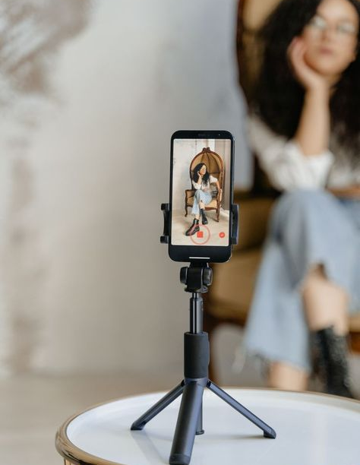

PR target audience Demographics
Journalists by professional
In field of entertainment
At local level in or around GTA
Have good reach
Must be full time
influencer

Slide 6
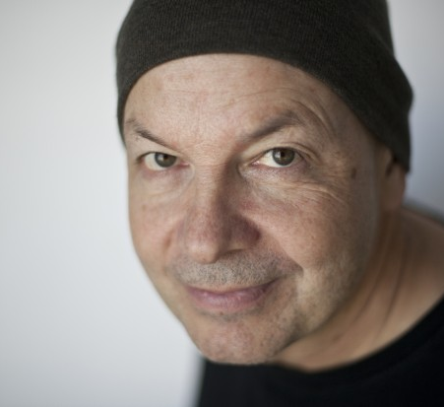
David Hayes
56 years old
Freelance journalist
Toronto based

Slide 7

Shay Mitchell
37
Social media influencer
Engagement rate is 75%

Slide 8
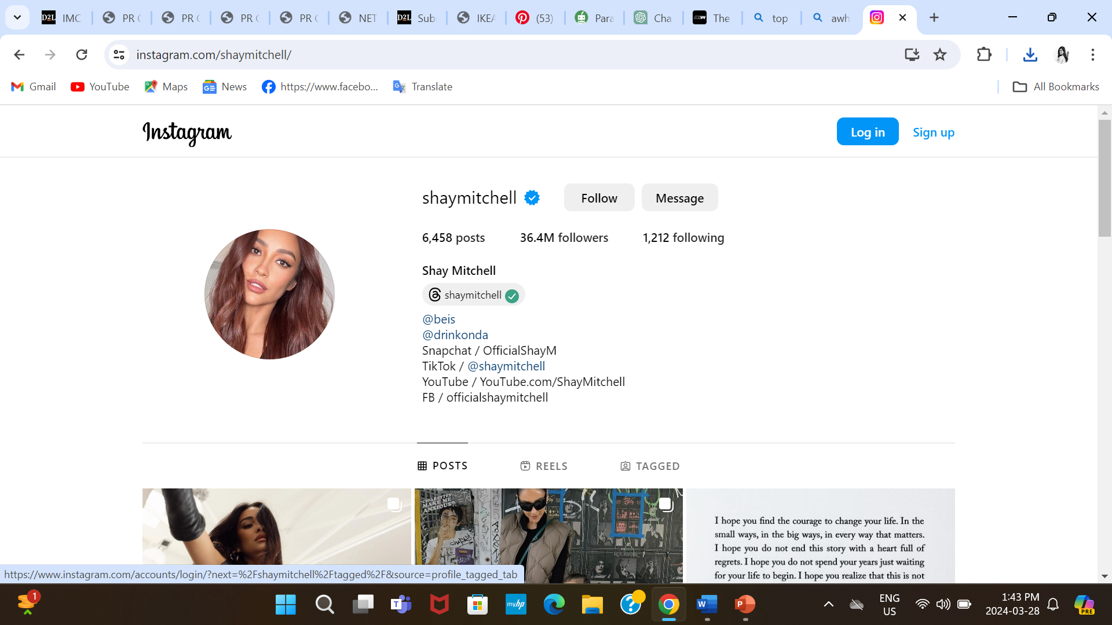

Slide 9

Ikea’s press kit

Slide 10
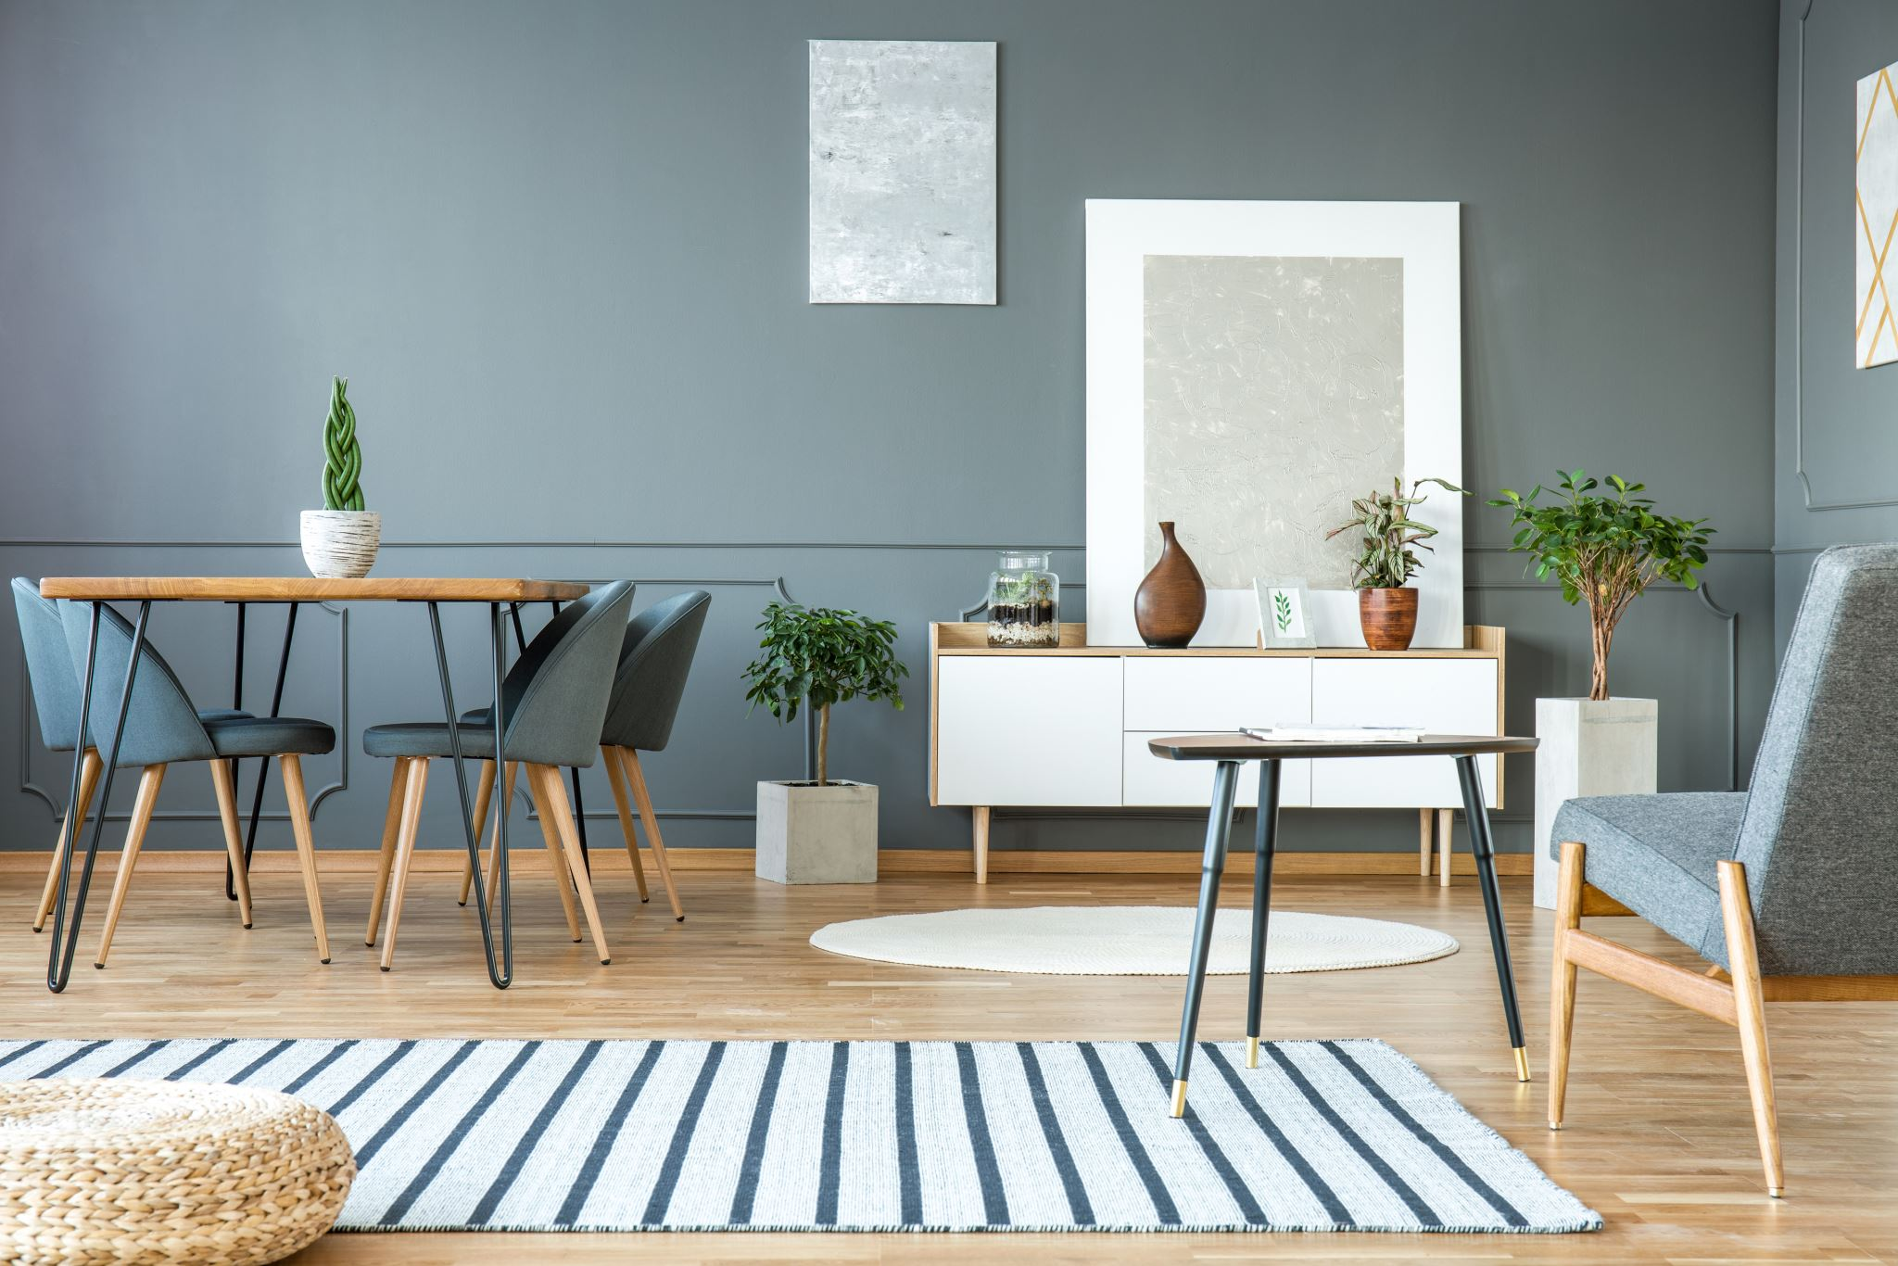
Key message
Explore IKEA: Transforming Spaces and Inspiring Lives. Discover our inventive ideas, smart solutions, and timeless style to create a home that is distinctly yours.

Slide 11
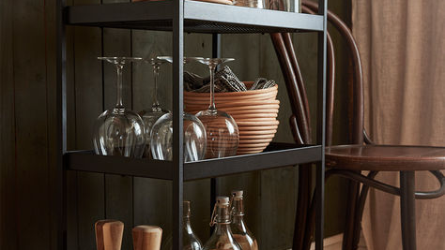
Outer cover

Slide 12


Slide 13

Cover letter

Slide 14
Dear David hayes,
We are thrilled invite you to attend the forthcoming event "IKEA styles discoveries" and are going to provide you with a press kit to cover it.
Ikea is committed to give best products and services to the customers. Our event will present some new products and we will guide the people how they can use our app “Ikea place” and save their time and try out all the new products by sitting at home. This have celebrities in it and that is making it more interesting.

Slide 15

An exciting, non forgettable event to make direct connect with customers. As a respected journalist with extensive understanding of the entertainment world, we believe your coverage of the event will provide significant value to your readers. We provide you access to our press kit, which includes first-hand information, images, and other tools for reporting.
Please reply back if you are interest to participate. Looking forward to meet you at the location.
Best Regards,
Ikea Press team
Ikeapress@ca

Slide 16

Invitation

Slide 17
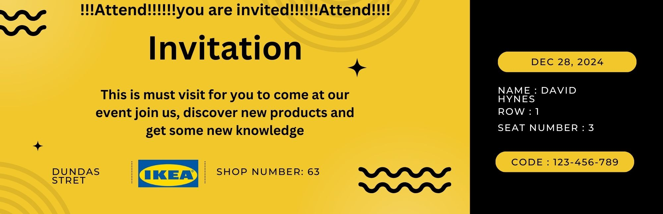

Slide 18

News Release

Slide 19
Ikea is creating the live home designs for the fans of IKEA’s products
What: interacting with customer with new modern designs and app
Who: Ikea users and future users
Where: Dundas street, Toronto
When: December, 28 2024
Why: To give solutions to customers

Slide 20
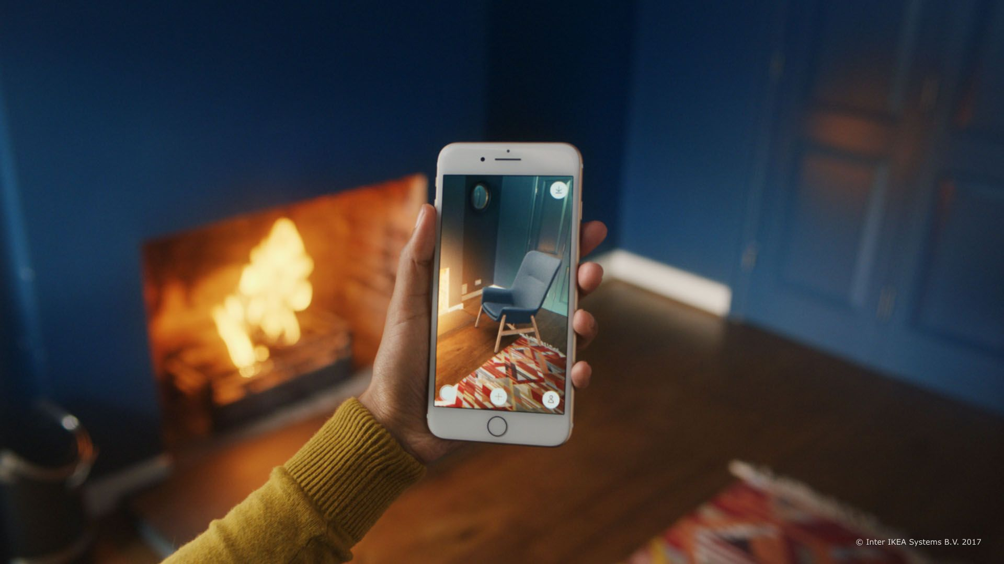
HOW: By using app “ikea place”

Slide 21
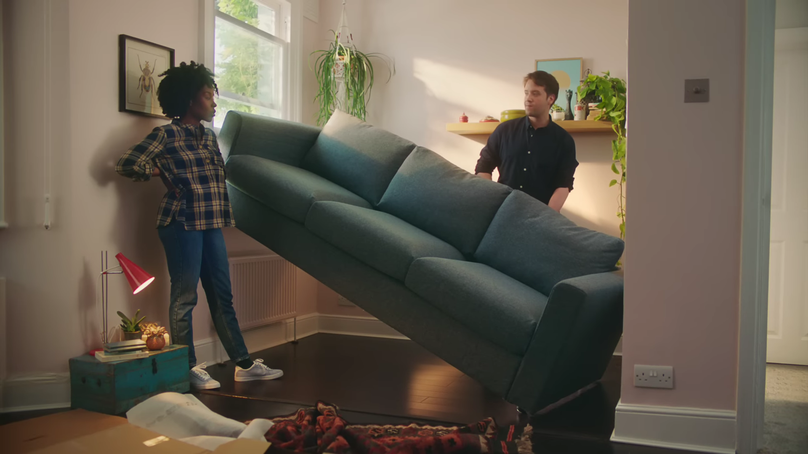
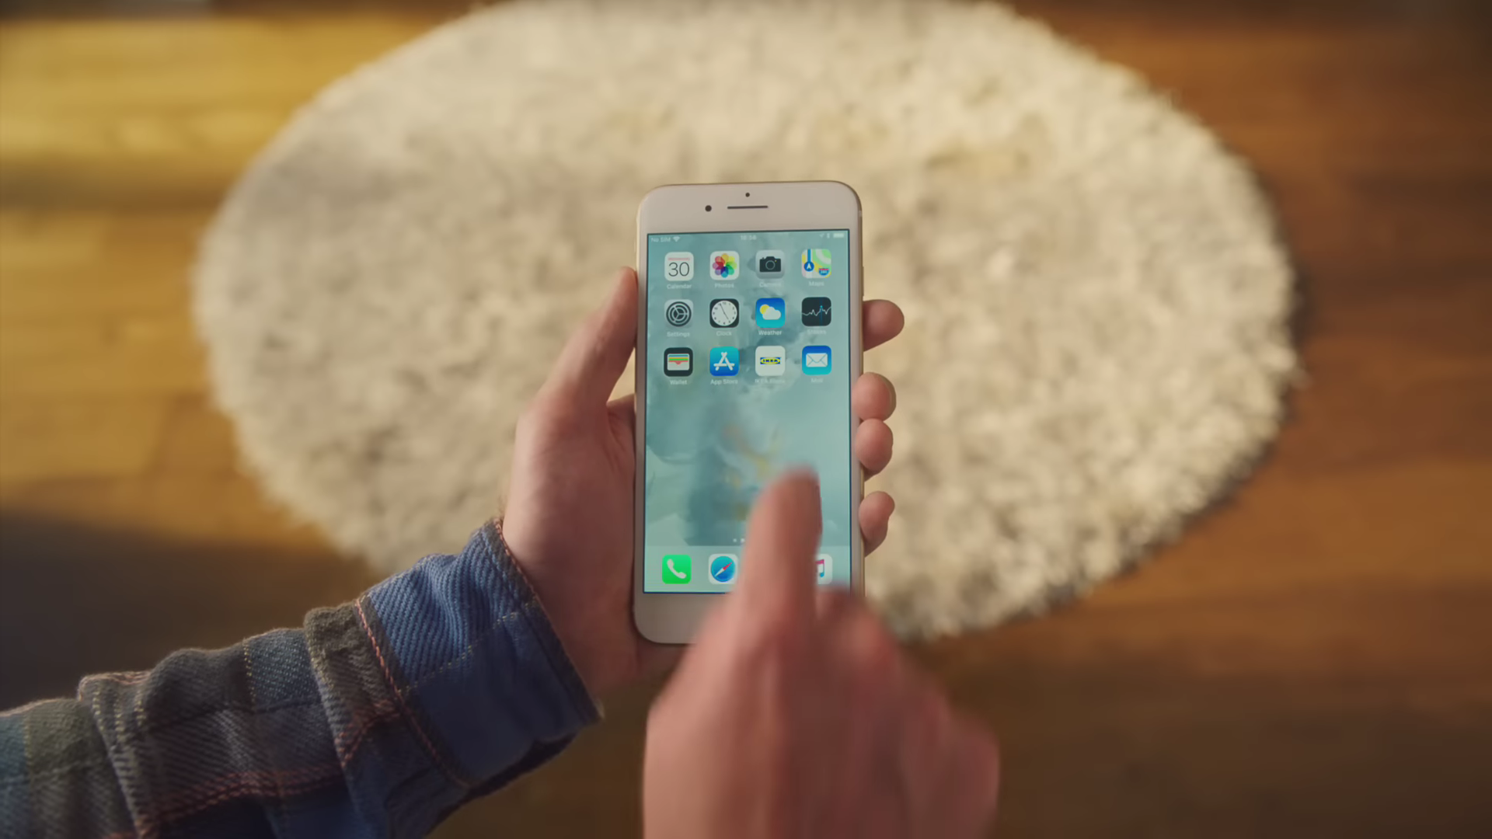

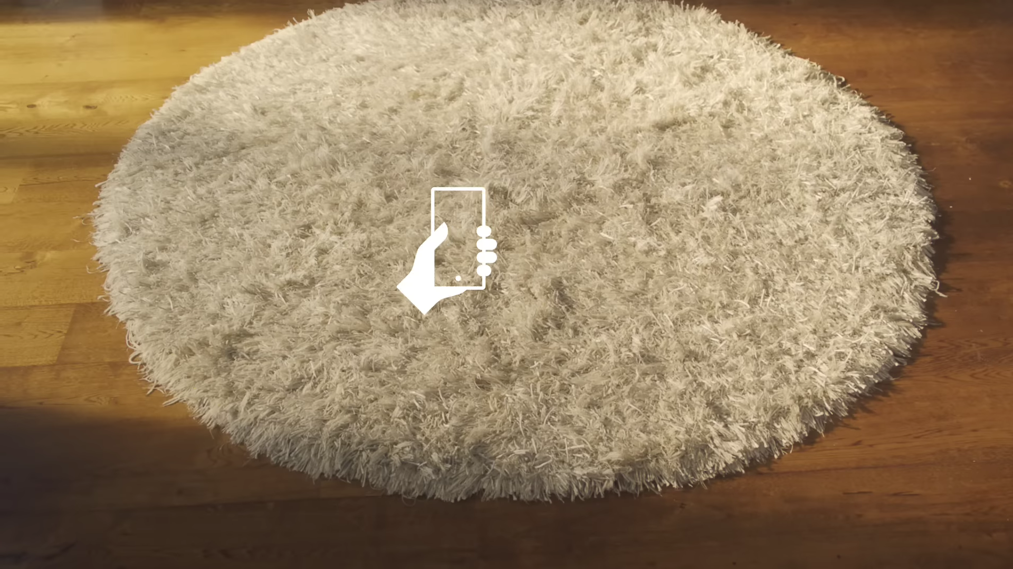
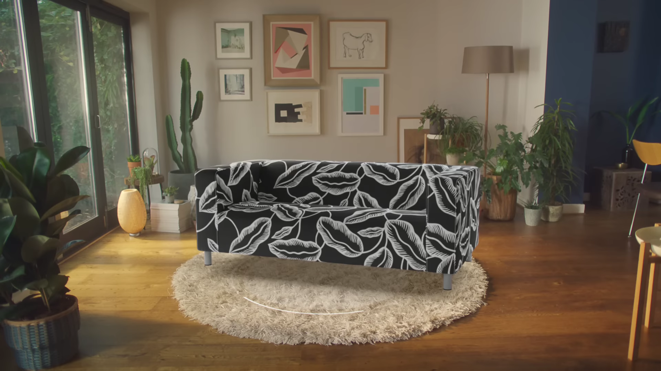

Slide 22
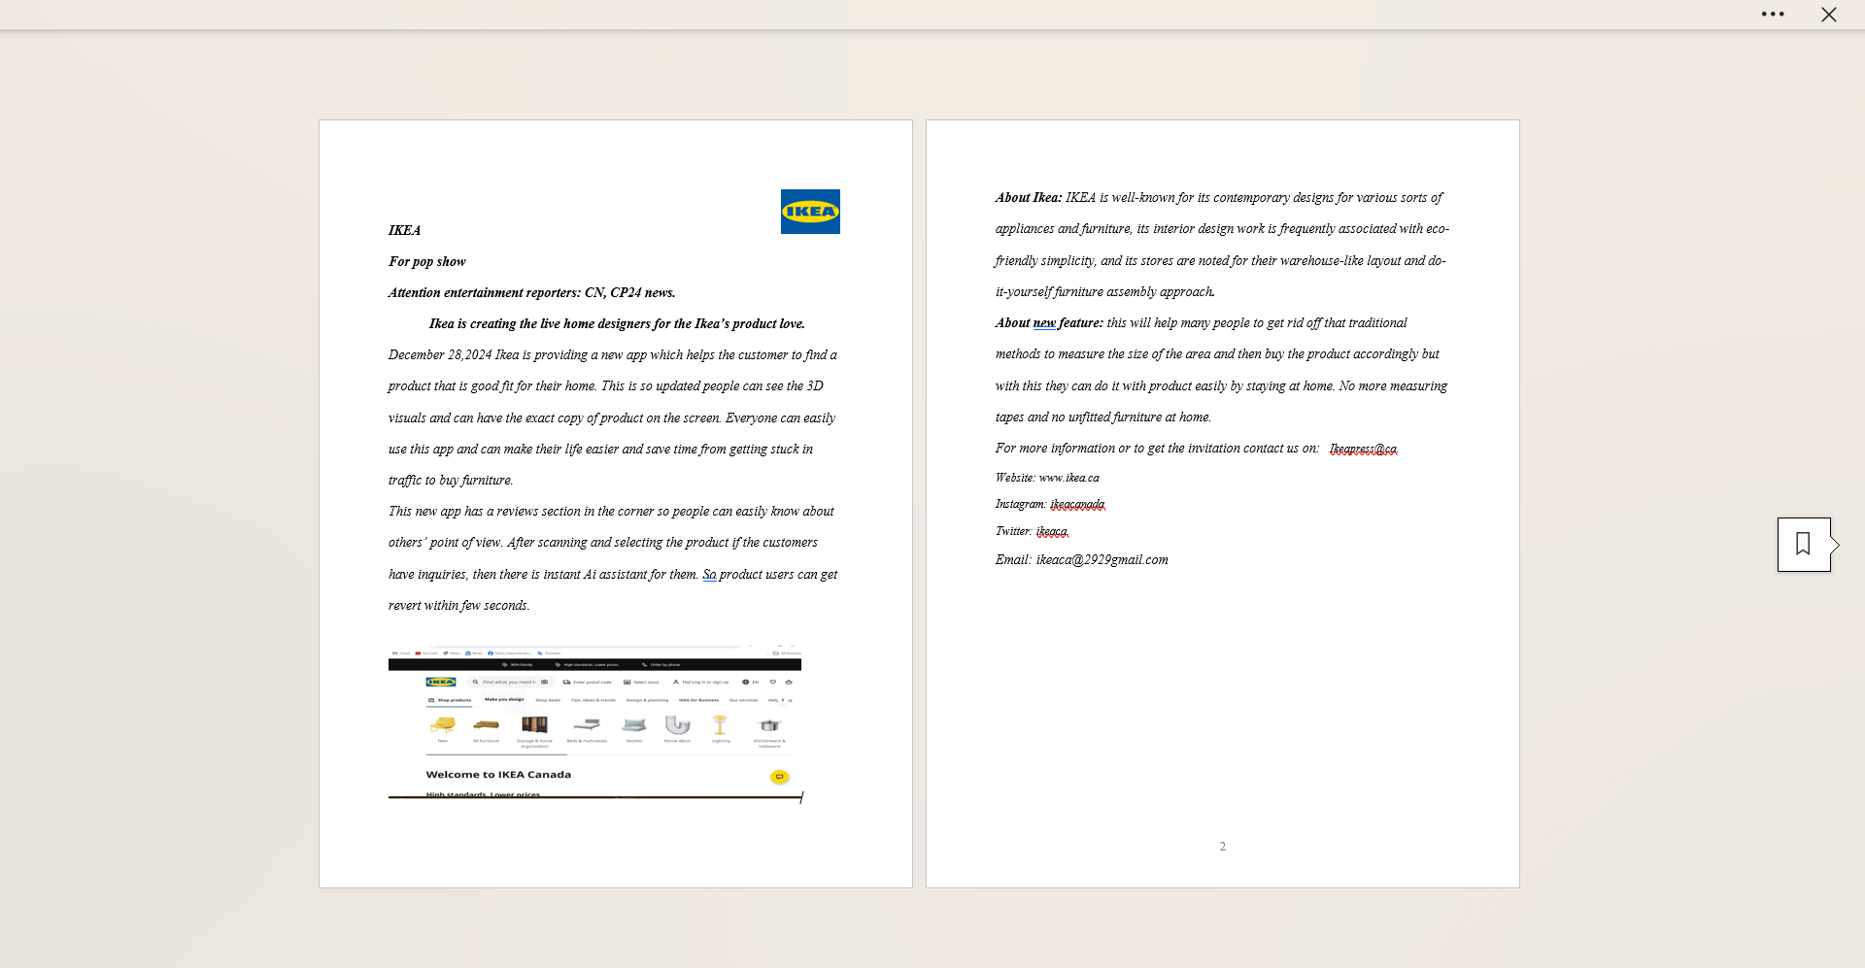

Slide 23
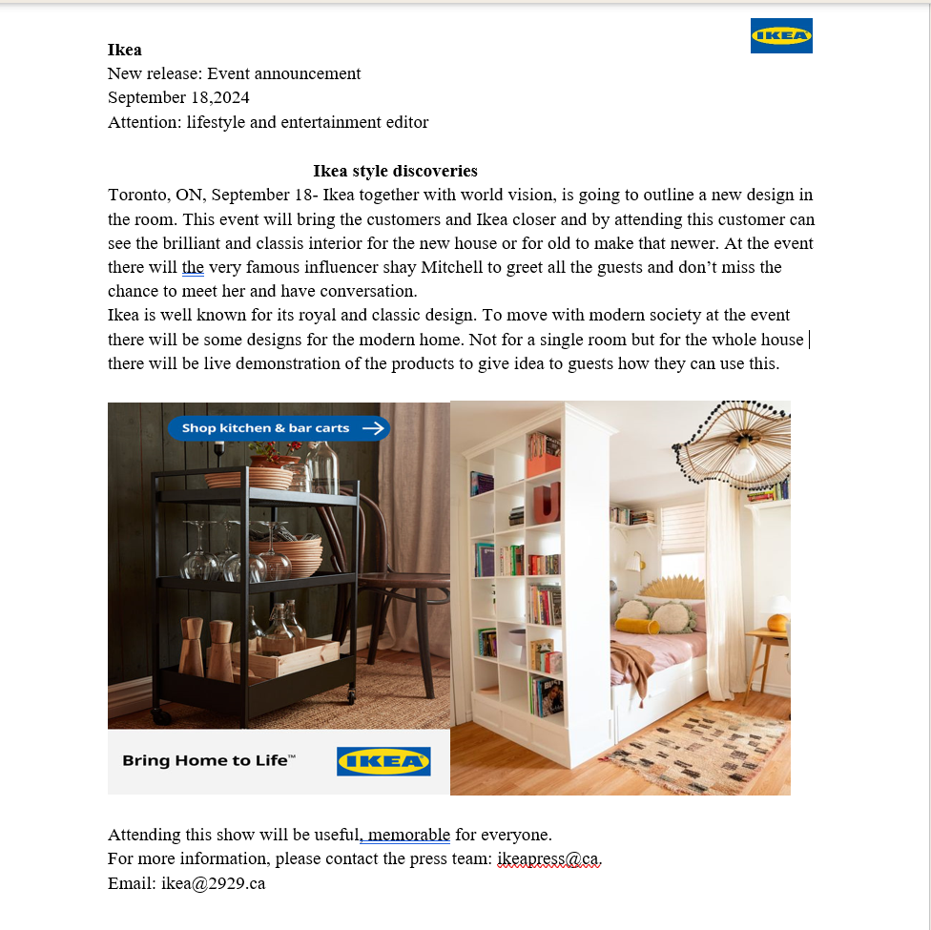

Slide 24
Fact sheets

Slide 25
Instagram: 512K youtube: 21.2 k
Facebook: 32m
IKEA, founded in 1943 in Sweden, is a renowned home furnishings shop that offers a large choice of well-designed, functional home furnishings at costs that are affordable to as many people as possible. IKEA Canada is part of the Ingka Group, which runs 389 IKEA shops across 32 countries, including 14 in Canada. This is well known brand with loyal customer.

Slide 26
Event details: Ikea style discoveries
Ikea developed idea of this event to connect with their customers and develop stronger bond. This is chance for the people who is confused about how to design the home to get rid of this confusion.
Where: Yonge-Dundas Square
Schedule: 12am: entry of shay Mitchell
1am: lesson on how to use the app
2am: interview by David

Slide 27
16 Stores
1 Distribution Centre
4 Customer Distribution Centres
1 Customer Support Centre
3 Plan and order points
4 Design studios
15 Collection points
35 Penguin PickUp locations
2 Wind farms
7,200+ Co-workers
4.5M IKEA Family members
21 IKEA in Canada IKEA Canada Summary R

Slide 28
Our partners
Giraffe food: In this 2 year relationship both of them worked for eachother.
No frills: the collaboration with ikea started in 2023 and they both support each other,
Rudsak: both are old partner from last 6 year.
RBC: the partnership between RBC and I kea is so beneficical and earning atleast 2 M because of each other.
World vision: Non- profit organisation working for the child is now partner with ikea and this is benefitting them both.

Slide 29






Slide 30
References
https://www.amworldgroup.com/blog/the-pr-event-playbook-a-guide-to-creating-and-planning-pr-events
https://davidhayes.ca/about/
https://www.imdb.com/name/nm3762213/bio/
https://www.ikea.com/ca/en/
https://www.ikea.com/ca/en/this-is-ikea/about-us/

